Slide 1
Mindustry Project Test Plan
Abdulrehman K, Afsah R, Hamza I, Fatima R

Slide 2
Project Introduction
Mindustry
factory-building game
Command units to capture enemy bases, and expand your production.
Defend your core from waves of enemies.
Mindustry was developed and published by Anuken, runs on the libGDX engine, and is available on Android, iOS, Microsoft Windows, Linux, and Mac operating systems.

Slide 3
Useful Resources
Github: https://mindustrygame.github.io/
Trello: https://trello.com/b/aE2tcUwF/mindustry-trello
Anuke: https://anuke.itch.io/mindustry
Discord: https://discord.com/invite/mindustry
Wiki: https://mindustrygame.github.io/wiki/
App store: https://apps.apple.com/us/app/mindustry/id1385258906?ign-mpt=uo%3D8

Slide 4
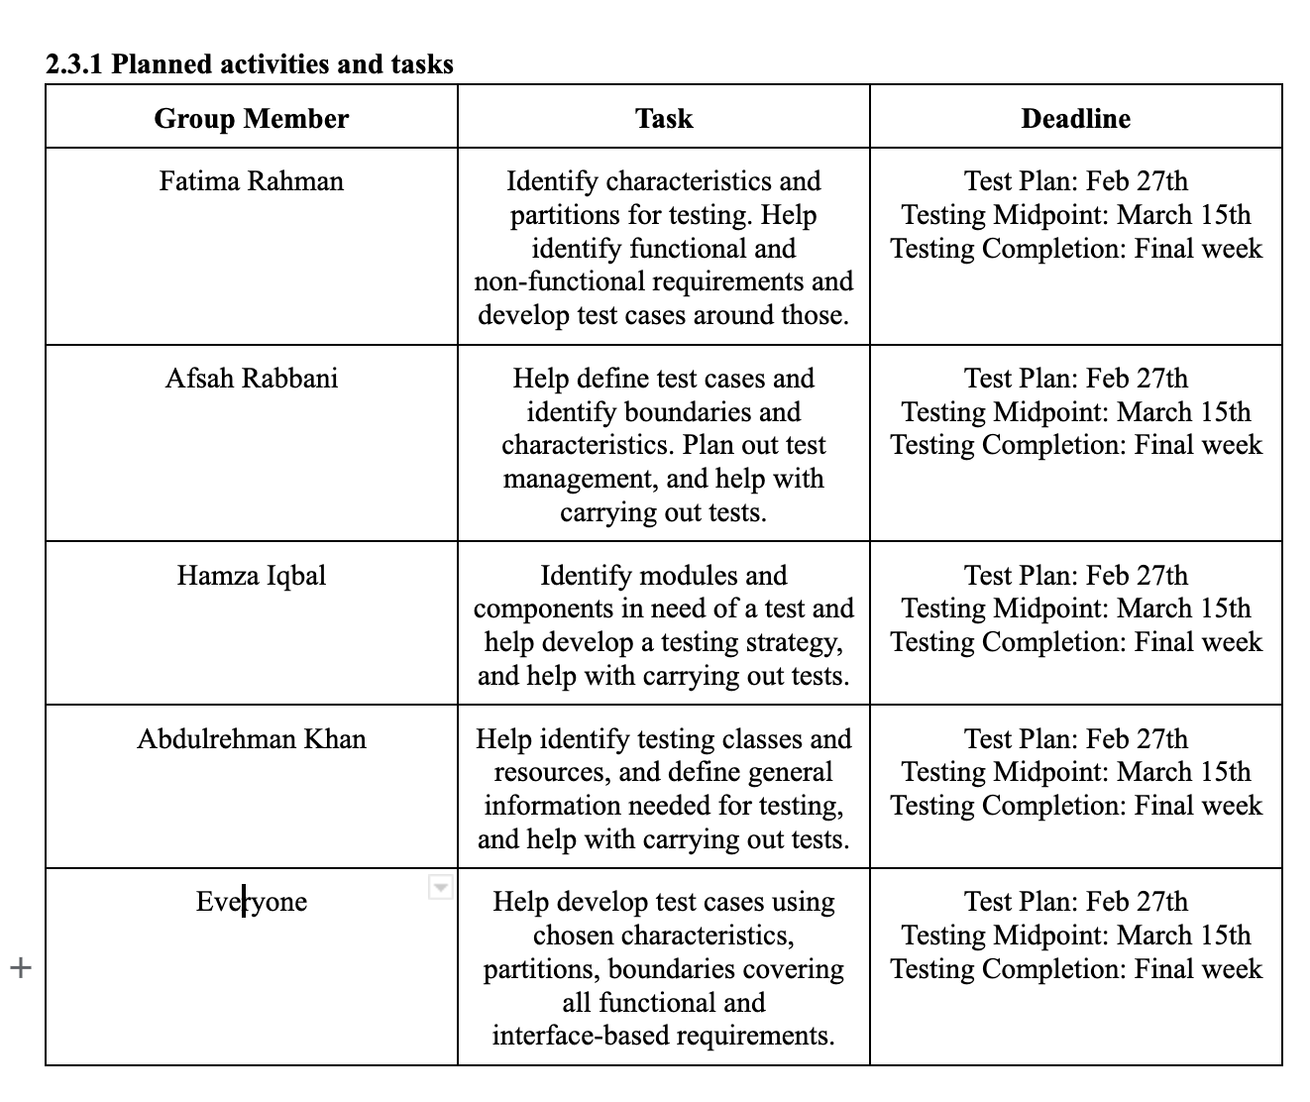

Slide 5
Scope + Documents To Be Done
Test Document: Functional and Non functional, Approaches, Criteria, Features to be Tested
Creation of Control Flow Graphs (CFGs)
Edge Coverage and Branch Coverage Reports
Faults Detected and Corrections
Discussion and Final Summary

Slide 6
2.2 Details for The Level Test Plan
Installation and Environment Set Up
Differs per system: Mac OS vs Linux vs Android vs Windows
Total Number of Outlined Tests: 12

Slide 7
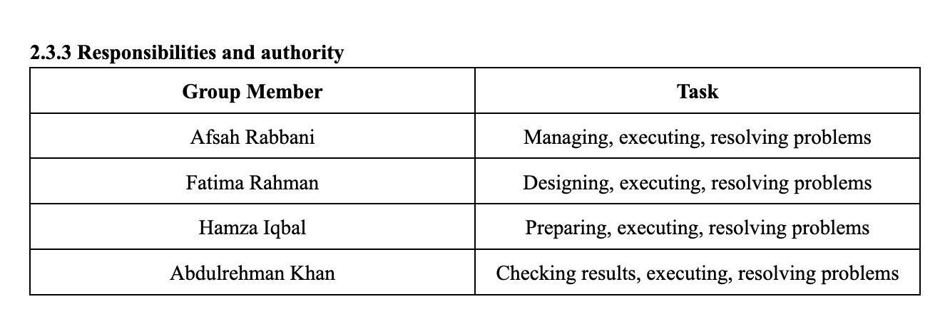

Slide 8
2.2.8 Test deliverables
Test plan outlining the requirements, features, and approach to testing. It also displays the objective.
Traceability matrix between test cases and requirements
A document of all executable test cases
A documents of test results, test coverage, and findings

Slide 9
2.4.2 Metrics
Test Coverage: Using Specific Tools (statement, branch, path)
Defect Density
Defect Escape Rate
Tests Cycle Time
Test Pass Rate
Test Case Effectiveness

Slide 10
Tools
Automation Tools:
Junit
Clover
Selenium
TestNG
Bug tracking tools:
Jira
Bugzilla
Asana
VSCode Debugger

Slide 11
THE END

